Slide 1



ITU WTSA Hackathon
AI Bharat 5G/6G Sandbox
26 Sep 2024
"Outreach Workshop on 26th Sept’2024 ”
Duration : 30mn

Slide 2
Outreach Workshop on 26th Sept’2024
26 Sep 2024
Agenda:
Overview of Problem Statements
Rules and Regulations
Phase wise tasks
Timeline
Evaluation criteria
Sample submission docs
An example problem

Slide 3

Problem Statement-1: Build Your Own AI/ML Model for 5G/6G
Describe the use case
Design and review the ML pipeline
Build the ML pipeline
Demo
Pick up specific usecases of their choice from a list of 5G/6G usecases.
Design and Build AI/ML pipelines corresponding to ITU-T Y.3172.
The resources provided to the participants may include open data, compute servers, and mentoring by ITU experts.
open to anyone including global participants

Slide 4
Problem Statement-1: Phase 1 and phase 2
Phase-1 (online):
Webinars, roundtables, mentoring.
call for 6G usecases, could be application or core usecase
Design ML pipelines,
Identify open data.
Model training
Phase-2 (in the room) AI Bharat 5G/6G Sandbox – Build Your Own AI/ML Model for 5G/6G
Model training & optimization
Testing and demo in Sandbox
open to anyone including global participants

Slide 5
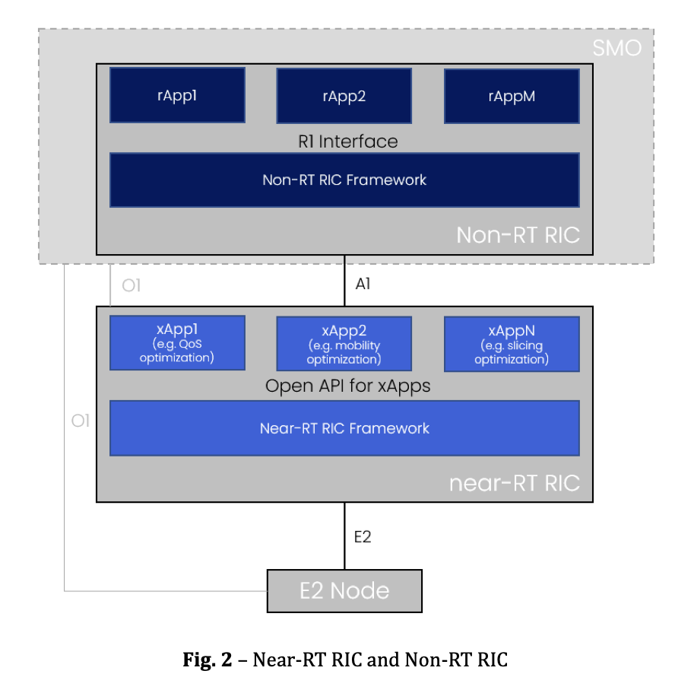
Problem Statement-2: Build Your Own xApp for Autonomous 5G/6G
Phase-1 (online):
Webinars, roundtables, mentoring.
design for xApps
Create custom xApp designs
Phase-2 (in the room)
xApp implementation and optimization
demo
Collection of xApps
ITU Journal on Future and Evolving Technologies, Volume 4, Issue 2, June 2023
Notes:
https://www.itu.int/pub/S-JNL-VOL4.ISSUE2-2023-A19 , "Towards autonomous open radio access networks”

Slide 6
Rules and Regulations
ITU WTSA Hackathon is open to anyone.
Participant- you could be a student, a startup, a small enterprise, a university professor, from anywhere. You are welcome to form a team and submit solutions.
We prepare mentoring sessions for you to code.
Mentor: If you are an experienced professional or teacher or professor or leader, we welcome your guidance in the form of mentoring to the teams.
Maximum 3 submissions are allowed per team.
Prizes
Awards will be given for:
1st Rank: $1000
2nd Rank: $700
3rd Rank: $500
Best Student Participant: $500
Best Startup Participant: $500
Best Female Participant: $500
Cloud credits will be arranged for selected teams for model training.
Teams can also use their own or open datasets. If needed dataset will be discussesd with selected teams ONLY.

Slide 7


Phase-1 tasks
Select use case e.g. ITU-T Y.Suppl 71]
Make a pipeline design
Submit and review the design
Use reference toolsets to demo
Register
https://challenge.aiforgood.itu.int/match/matchitem/95
Submit design
Examples are here
Got Questions?
Ask in the AI/ML 5G Challenge Slack or forums. here
Notes:
https://challenge.aiforgood.itu.int/match/matchitem/95
https://github.com/CrashingGuru/ITU_WTSA_HACKATHON
https://join.slack.com/t/itu-challenge/shared_invite/zt-2oabtngbm-oczQzPp3zUbwk~hR2EForQ

Slide 8
Phase-2 tasks
Implement your design
Test and validate
Demonstrate the solution
Submit solution and demo
Phase 2: (7th-8th October 2024)
- In-person, at Bharat Mandapam, New Delhi
- Two-day coding event
- Participants: Selected from Phase-1

Slide 9
Timeline
Phase 1: (August – September)
- Launch of Portal and Online Webinar: 7th August 2024 - Mentoring Events: August - September 2024 - Registration Closes: 28th September 2024 - Submission Deadline: 28th September 2024 - Announcement of Shortlisted Teams: 30th September 2024
Phase 2: (7th-8th October 2024)
Shortlisted teams to meet at the Bharat Mandapam, New Delhi
All previous sessions recording are here
Notes:
https://challenge.aiforgood.itu.int/forum/article/38

Slide 10
Evaluation Criteria
Phase 1:
Relevance of use case to Sustainable development goals (SDG), AI, Standards, and 5G. (0.2)
Clarity of AI/ML pipeline (0.2)
Completeness of design documentation (0.3)
Readiness for Phase-2 including Self-test designs, YAML code (0.2)
Relation to standards (e.g. ITU-T Y.3172, ITU-T Y.3061) (0.1)
Phase 2:
Demonstration in orchestrator platform, Cloud platform. (0.5)
Clear concept explanation of AI/ML (0.3)
completeness of submission including code repository. (0.2)
Final Score:
added sum of phase-1 and phase-2, out of 200
Notes:
https://www.itu.int/rec/T-REC-Y.3172-201906-I/en
https://www.itu.int/rec/T-REC-Y.3061-202312-I

Slide 11
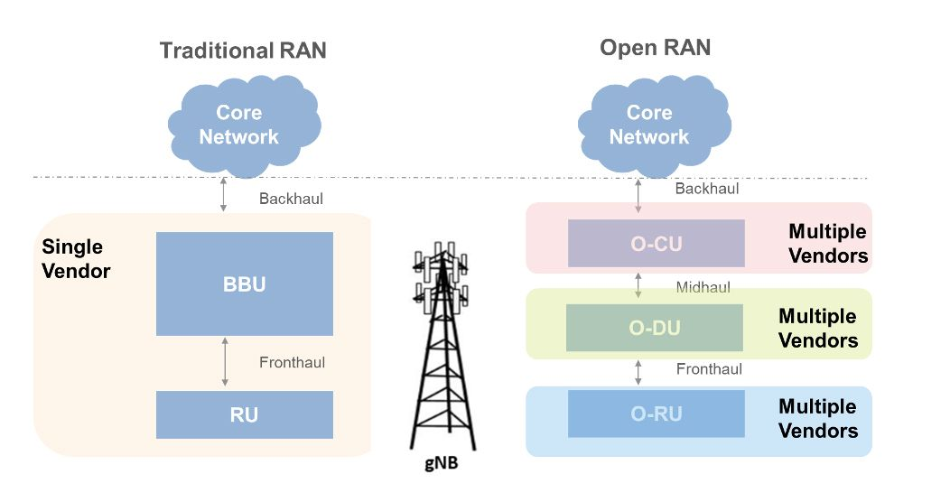
Introduction
Problem Statement-2:
https://uk.mathworks.com/discovery/o-ran.html
What Is Open RAN (O-RAN)? - MATLAB & Simulink (mathworks.com)
Notes:
https://in.mathworks.com/discovery/o-ran.html

Slide 12
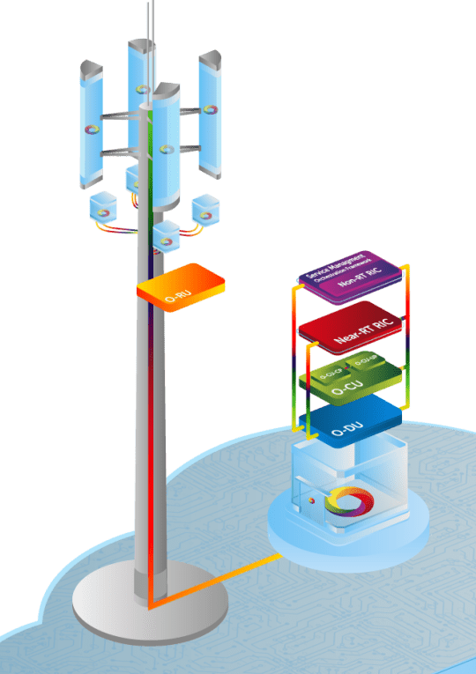
High-level Overview of O-RAN
Problem Statement-2:
Radio Unit (O-RU)
Distributed Unit (O-DU)
Centralized Unit (O-CU)
(Near) Real-Time RIC (rtRIC)
This is where xApps live
Non-Real-Time RIC (ntRIC)
This is where rApps live
https://www.o-ran.org/
Notes:
Ref link: https://www.o-ran.org/

Slide 13
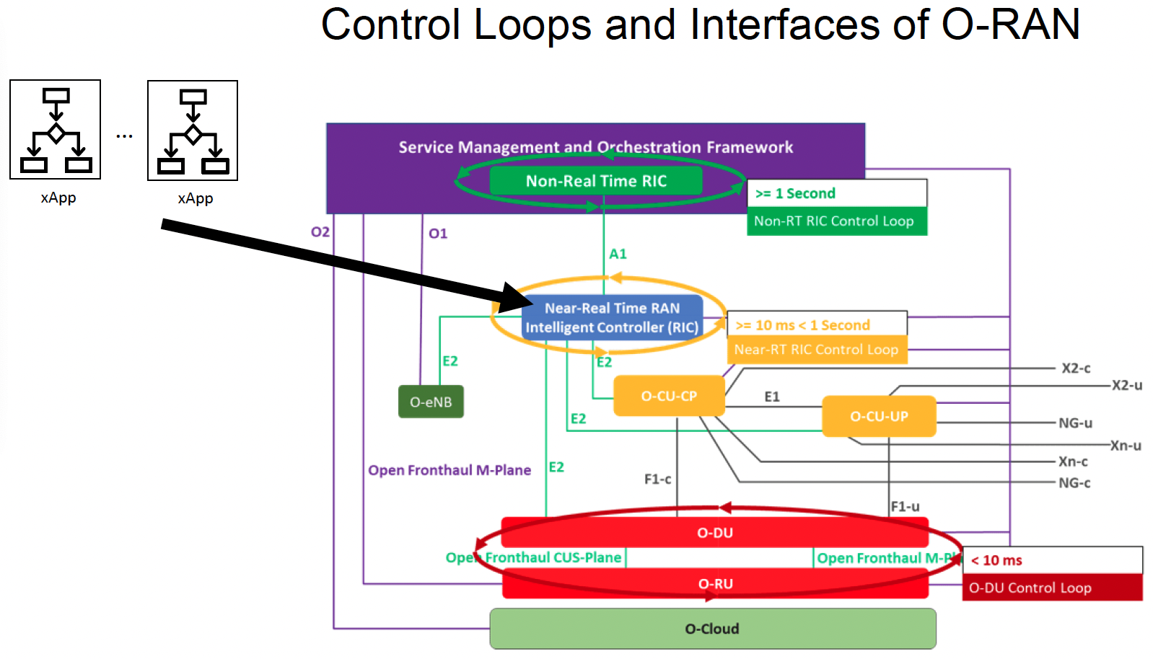
Problem Statement-2:
Open RAN Series: Open RAN Intelligence (Part 3 of 3) (aspiretechnology.com)
Notes:
Link: https://www.aspiretechnology.com/blog/open-ran-series-open-ran-intelligence-part-3-of-3/

Slide 14
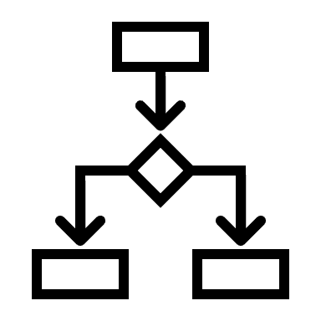
xApps
Problem Statement-2:
xApps are intended to implement RAN functions: -
Dynamic optimization
Closed-loop automation
Service differentiation
Load balancing
Traffic Steering
Mobility
Energy efficiency
Coverage optimization
https://www.itu.int/en/ITU-T/focusgroups/an/Documents/Use-case-AN.pdf
Use cases for Autonomous Networks (itu.int)
Notes:
Ref link: https://www.itu.int/en/ITU-T/focusgroups/an/Documents/Use-case-AN.pdf

Slide 15
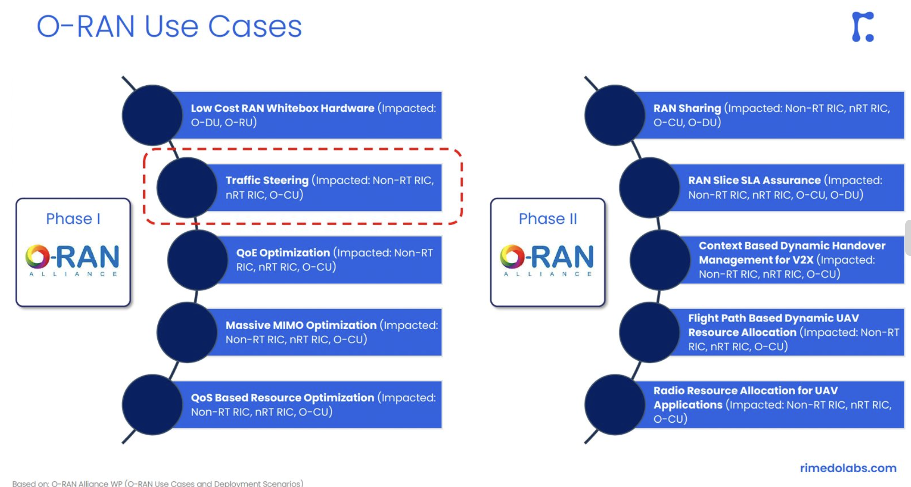
Problem Statement-2:
https://rimedolabs.com/
Notes:
https://rimedolabs.com/blog/rimedo-labs-to-integrate-qra-xapp-with-onfs-sd-ran/

Slide 16
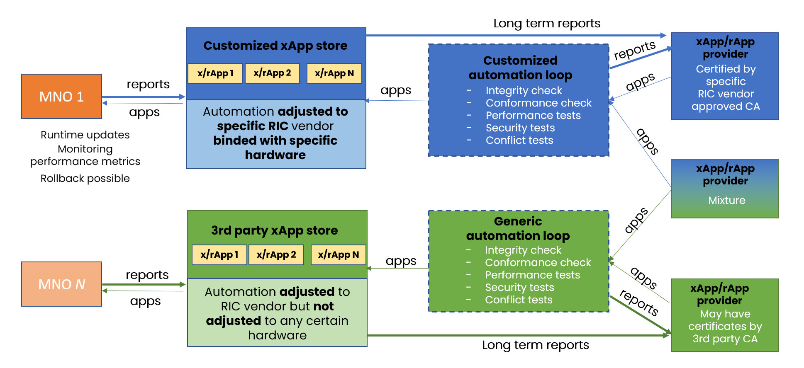
Towards Autonomous Open Radio Access Networks
Problem Statement-2:
Adrian Kliks, Marcin Dryjanski, Vishnu Ram OV, Leon Wong, Paul Harvey. May, 2023
Notes:
https://www.itu.int/pub/S-JNL-VOL4.ISSUE2-2023-A19 “Towards autonomous open radio access networks” , ITU J-FET paper.

Slide 17
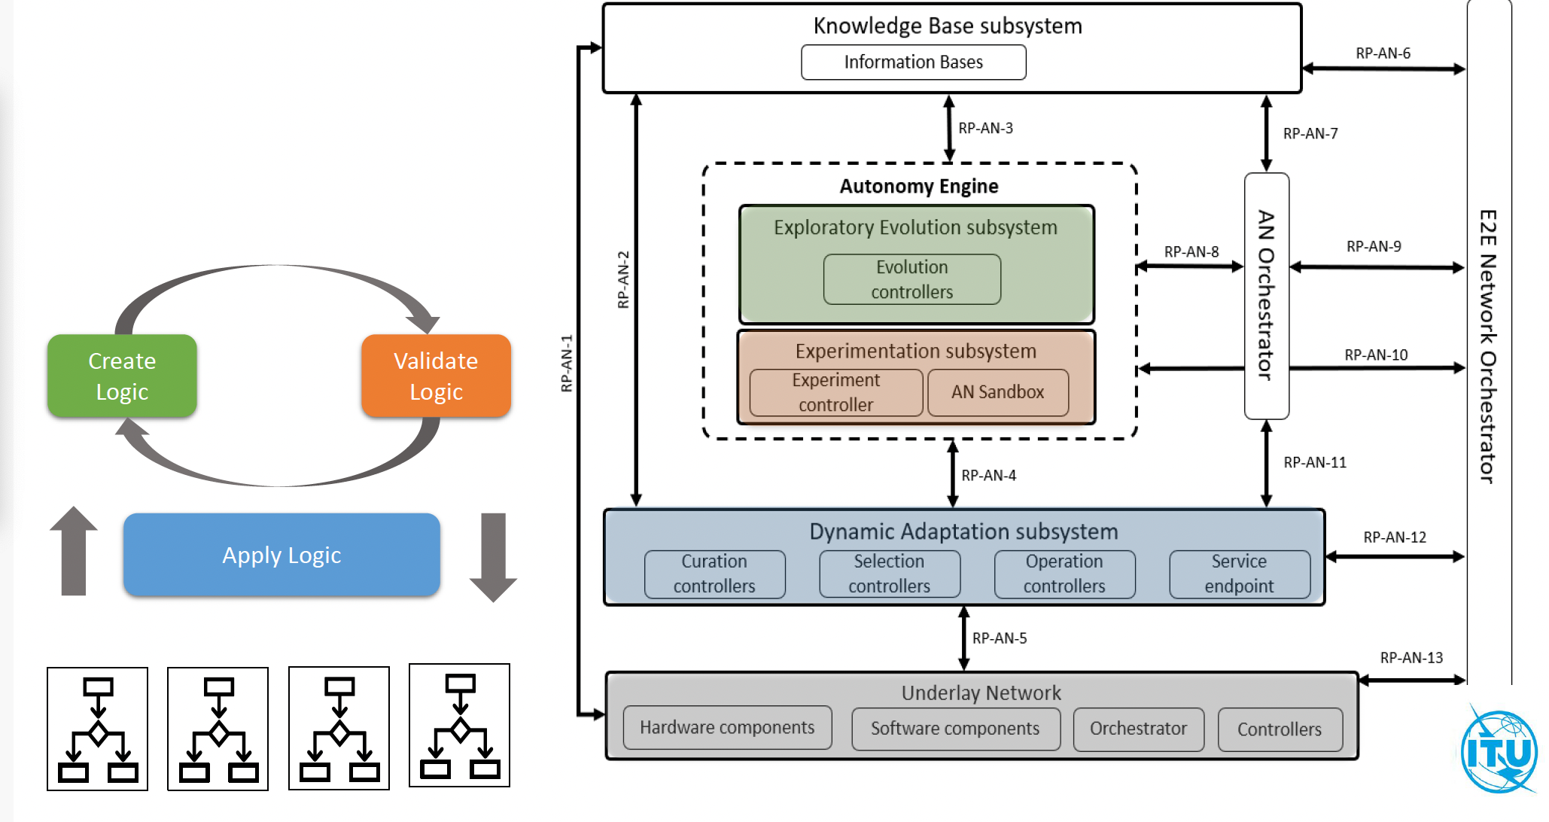
Problem Statement-2:
https://www.itu.int/rec/T-REC-Y.3061-202312-I
Notes:
https://www.itu.int/rec/T-REC-Y.3061-202312-I

Slide 18
AI Bharat 5G/6G Sandbox – Build Your Own xApp for Autonomous 5G/6G - Goals
Problem Statement-2:
How to create an xApp for a specific 5G/6G use case that:
Can interact with the ITU Y.3061 architecture framework
Is modular and configurable at runtime
Can be validated on the AI Bharat 5G/6G Sandbox via the ITU Y.3061 architecture framework
What are options in the composition of the xApp
Different optimisation strategies, data fusion approaches, execution actions
What does the intent for an xApp look like?
How to define ‘good’ for an xApp and Use Case?
Notes:
https://challenge.aiforgood.itu.int/forum/article/38

Slide 19

Refer to mentoring session-2: Flowchart for submission
choose
use case
Design Pipeline
Design
xApp
Submit app.py file along with config file and E2 messages
Step-1
Step-2
Step-3
Step-4
Optional - Test the xApp in own Sandbox setup
Notes:
Mentoring session-2: https://itu.zoom.us/rec/share/n3RoIgMzGb9H4SFEK7hDKWseyaoJDwNQScRokjmul8l5evqdmYcRNV7cWYsBFjho.vIPyVp6N8X3GWAXH

Slide 20
Design submission details
Document header: Author details, affiliation and contacts
Clause-1: use case introduction
Clause-2: use case requirements
Clause-3: PS1: pipeline design
Clause-4: PS2: xApp design
Clause-5: Relation to Standards.
Clause-6: Code submission details
Clause-7: Self-Testing results
sample document from github will be shown
CrashingGuru/ITU_WTSA_HACKATHON: This repo contains the supporting materials for ITU WTSA Hackathon planned on 07 and 08 Oct 2024 in New Delhi. (github.com)
Notes:
https://github.com/CrashingGuru/ITU_WTSA_HACKATHON

Slide 21
Code submission details
commit app.py or other files to your GitHub repo.
refer to mentoring session 2 for creating repo.
link to mentoring session-2: ITU WTSA-24 AI Bharat 5G/6G Sandbox Hackathon Mentoring Session #2 – Zoom
GitHub repo link here: https://github.com/CrashingGuru/ITU_WTSA_HACKATHON/tree/main/Example-4/Doc
Notes:
https://itu.zoom.us/rec/share/n3RoIgMzGb9H4SFEK7hDKWseyaoJDwNQScRokjmul8l5evqdmYcRNV7cWYsBFjho.vIPyVp6N8X3GWAXH
https://github.com/CrashingGuru/ITU_WTSA_HACKATHON/tree/main/Example-4/Doc

Slide 22
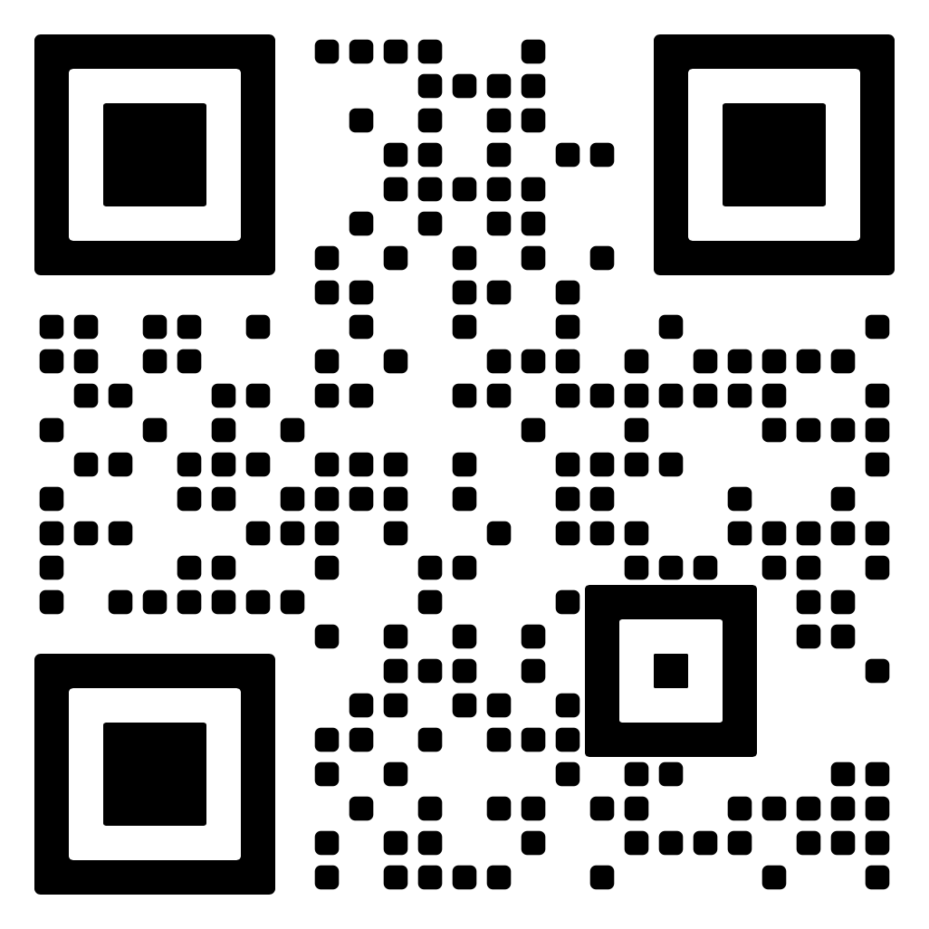
Examples
Let us see one of the example document from the following: https://github.com/CrashingGuru/ITU_WTSA_HACKATHON
“A midnight Robbery”
ITU_WTSA_HACKATHON/Example-4/Doc/Sample -4.docx at main · CrashingGuru/ITU_WTSA_HACKATHON (github.com)
example doc from the github covers
Slides 6,7,8,9,10,12, 14 from the 28 Sep mentoring session.

Slide 23
Open Data Repository AI for Good-Innovate for Impact (itu.int)
Usecase-3: https://hungary-simtool.herokuapp.com/SimulationDashBoard/downloads
Description: This is a data analytics platform providing downloadable datasets and insights on various economic and social indicators for Hungary. The tool offers comprehensive data downloads for research, policy-making, and strategic planning purposes.
Usecase-5: https://agmarknet.gov.in/PriceAndArrivals/CommodityDailyStateWise.aspx
Description: The Agmarknet portal provides daily commodity price and arrival information for various agricultural products across different states in India.
Usecase-18: https://www.mapbox.com/access/traffic-sample-data
Description: Mapbox Traffic Sample Data provides a comprehensive dataset of real-time and historical traffic information, enabling developers to build and test traffic-aware applications. This sample data includes GPS trajectories, traffic incidents, and congestion metrics for various locations worldwide.
Notes:
Refer to report here: https://www.itu.int/net/epub/TSB/2024-AI-for-Good-Innovate-for-Impact-final-report/files/downloads/2401077_Final-Use-cases-collection-E.pdf

Slide 24
Open Data Repository AI for Good-Innovate for Impact (itu.int)
Use case-22: https://drive.google.com/drive/folders/1HPcJzwKi76WwCFYj7dHUgVA31dAyFyTF
Description: This data is stored in a google drive. This data sets contains information about AI-Rapid TB Diagnosis
Usecase-33: https://revistas.uniandes.edu.co/index.php/nys/article/view/1151/8626
Description: This data set is from Naturaleza y Sociedad. The Satellite detection data can be analyzed from the above reference.
Usecase-39: https://www.openstreetmap.org/#map=4/21.84/82.79
Description: The above data is from the Open Street Map. You can able to access Public GPS Traces, User Diaries, geographic information data.
Usecase-52: https://public.roboflow.com/
Description: You can access and view all the Computer Vision Related datasets here.

Slide 25
Open Data Repository AI for Good-Innovate for Impact (itu.int)
Use case-53:
https://laion.ai/blog/laion-5b/
Description: LAION-5B is a large-scale dataset of 5 billion image-text pairs, designed for training and evaluating AI models, particularly text-to-image and image-to-text models. This dataset contains a vast collection of images paired with descriptive text captions, enabling research and development in computer vision, natural language processing, and multimodal learning.
https://github.com/ksOAn6g5/TaiSu
Description: This GitHub repository provides the model's code, documentation, and pre-trained weights for researchers and developers. You can also find the Paper link here: pdf (openreview.net)
https://wukong-dataset.github.io/wukong-dataset/index.html
Description: The Wukong Dataset is a large-scale, multilingual, and multimodal dataset for evaluating and training AI models, focusing on cross-cultural and cross-lingual understanding. This dataset comprises text, images, and audio data from various sources, covering diverse topics and languages.

Slide 26




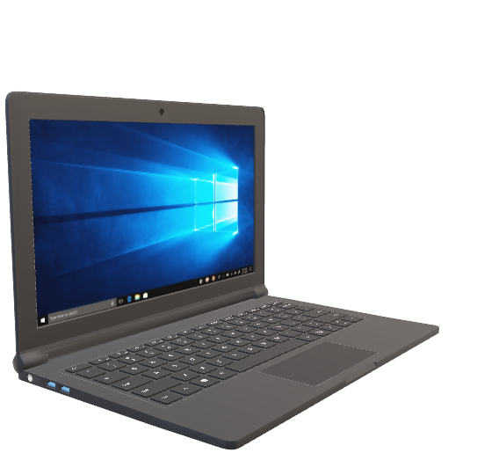

Selected Participants will get access to Free GPUs.
step-1: submit the design as per sample docs
step-2: wait for selection
step-3: refer to mentoring session-4
Selected
participant
Cloud server

Slide 27
References
[1] ITU-T Recommendation Y.3172 : Architectural framework for machine learning in future networks including IMT-2020
[2] ITU-T Recommendation Y.3179 : Architectural framework for machine learning model serving in future networks including IMT-2020
[3] ITU-T Recommendation Y.3181 : Architectural framework for machine learning sandbox in future networks including IMT-2020
[4] ITU Journal on Future and Evolving Technologies, Volume 3 (2022), Issue 2, “Network resource allocation for emergency management based on closed-loop analysis”, https://doi.org/10.52953/HVPI8935
[5] ITU-T FG AN Input document FGAN-I-329-R1 Open AI Cellular (OAIC), OpenRAN Gym & FlexRIC: Simulated platforms and underlays for Build-a-thon 2024
[6] Marco, Giordani., Michele, Polese., Marco, Mezzavilla., Sundeep, Rangan., Michele, Zorzi. "Toward 6G Networks: Use Cases and Technologies." IEEE Communications Magazine, 58 (2020).:55-61. doi: 10.1109/MCOM.001.1900411
[7] https://openaicellular.github.io/oaic/xapp_python.html
[8] Trouble Shooting Guide for xApp deployment (OAIC)
[9] https://www.itu.int/dms_pub/itu-s/opb/jnl/S-JNL-VOL4.ISSUE2-2023-A19-PDF-E.pdf
[10] ITU-T Recommendation Y.3061 https://www.itu.int/rec/T-REC-Y.3061-202312-I

Slide 28
Q&A Session
Q6) how do I create xApp?
A6) Using the OAIC examples. Given in mentoring sessions.
Q7) where are the recordings for the mentoring sessions?
A7) Please refer here: https://challenge.aiforgood.itu.int/forum/article/39
Q8) what are the prizes?
A8) Please refer to slide – 6
Q9) how will I show demo?
A9) Selected candidates will do a presentation and demo using cloud platforms in Delhi. Demo Format will be disused with selected candidates after 30th September
Q10) when should I submit?
A10) You have to submit before 28th September, 12:00 Mid-night IST.
Q11) can I reuse the examples?
A11) No, you can not reuse the examples, however, it can be modified with significant and unique changes.
Q1) what are the criteria for selection?
A1) Refer to Evaluation criteria (slide-10)
Q2) will I get travel support?
A2) Selected candidates will get travel support to Delhi. Upto 4 members per team can be supported.
Q3) what are the use cases?
A3) Any use-case applying AI for SDG’s (Sustainable Development Goals) with Network see examples and mentoring sessions. Refer here: ITU Challenge https://github.com/CrashingGuru/ITU_WTSA_HACKATHON
Q4) should I use only ITU references?
A4) No, you can use any standard references as long as they are cited in the submission.
Q5) where can I get datasets? where can I get GPUs?
A5) Data sets depends on the design., if your design is selected, ITU will contact you for data sets if required.
GPUs are made available in the cloud.
Notes:
Reference 1:https://challenge.aiforgood.itu.int/forum/article/38
Git hub ref: https://github.com/CrashingGuru/ITU_WTSA_HACKATHON

Slide 29
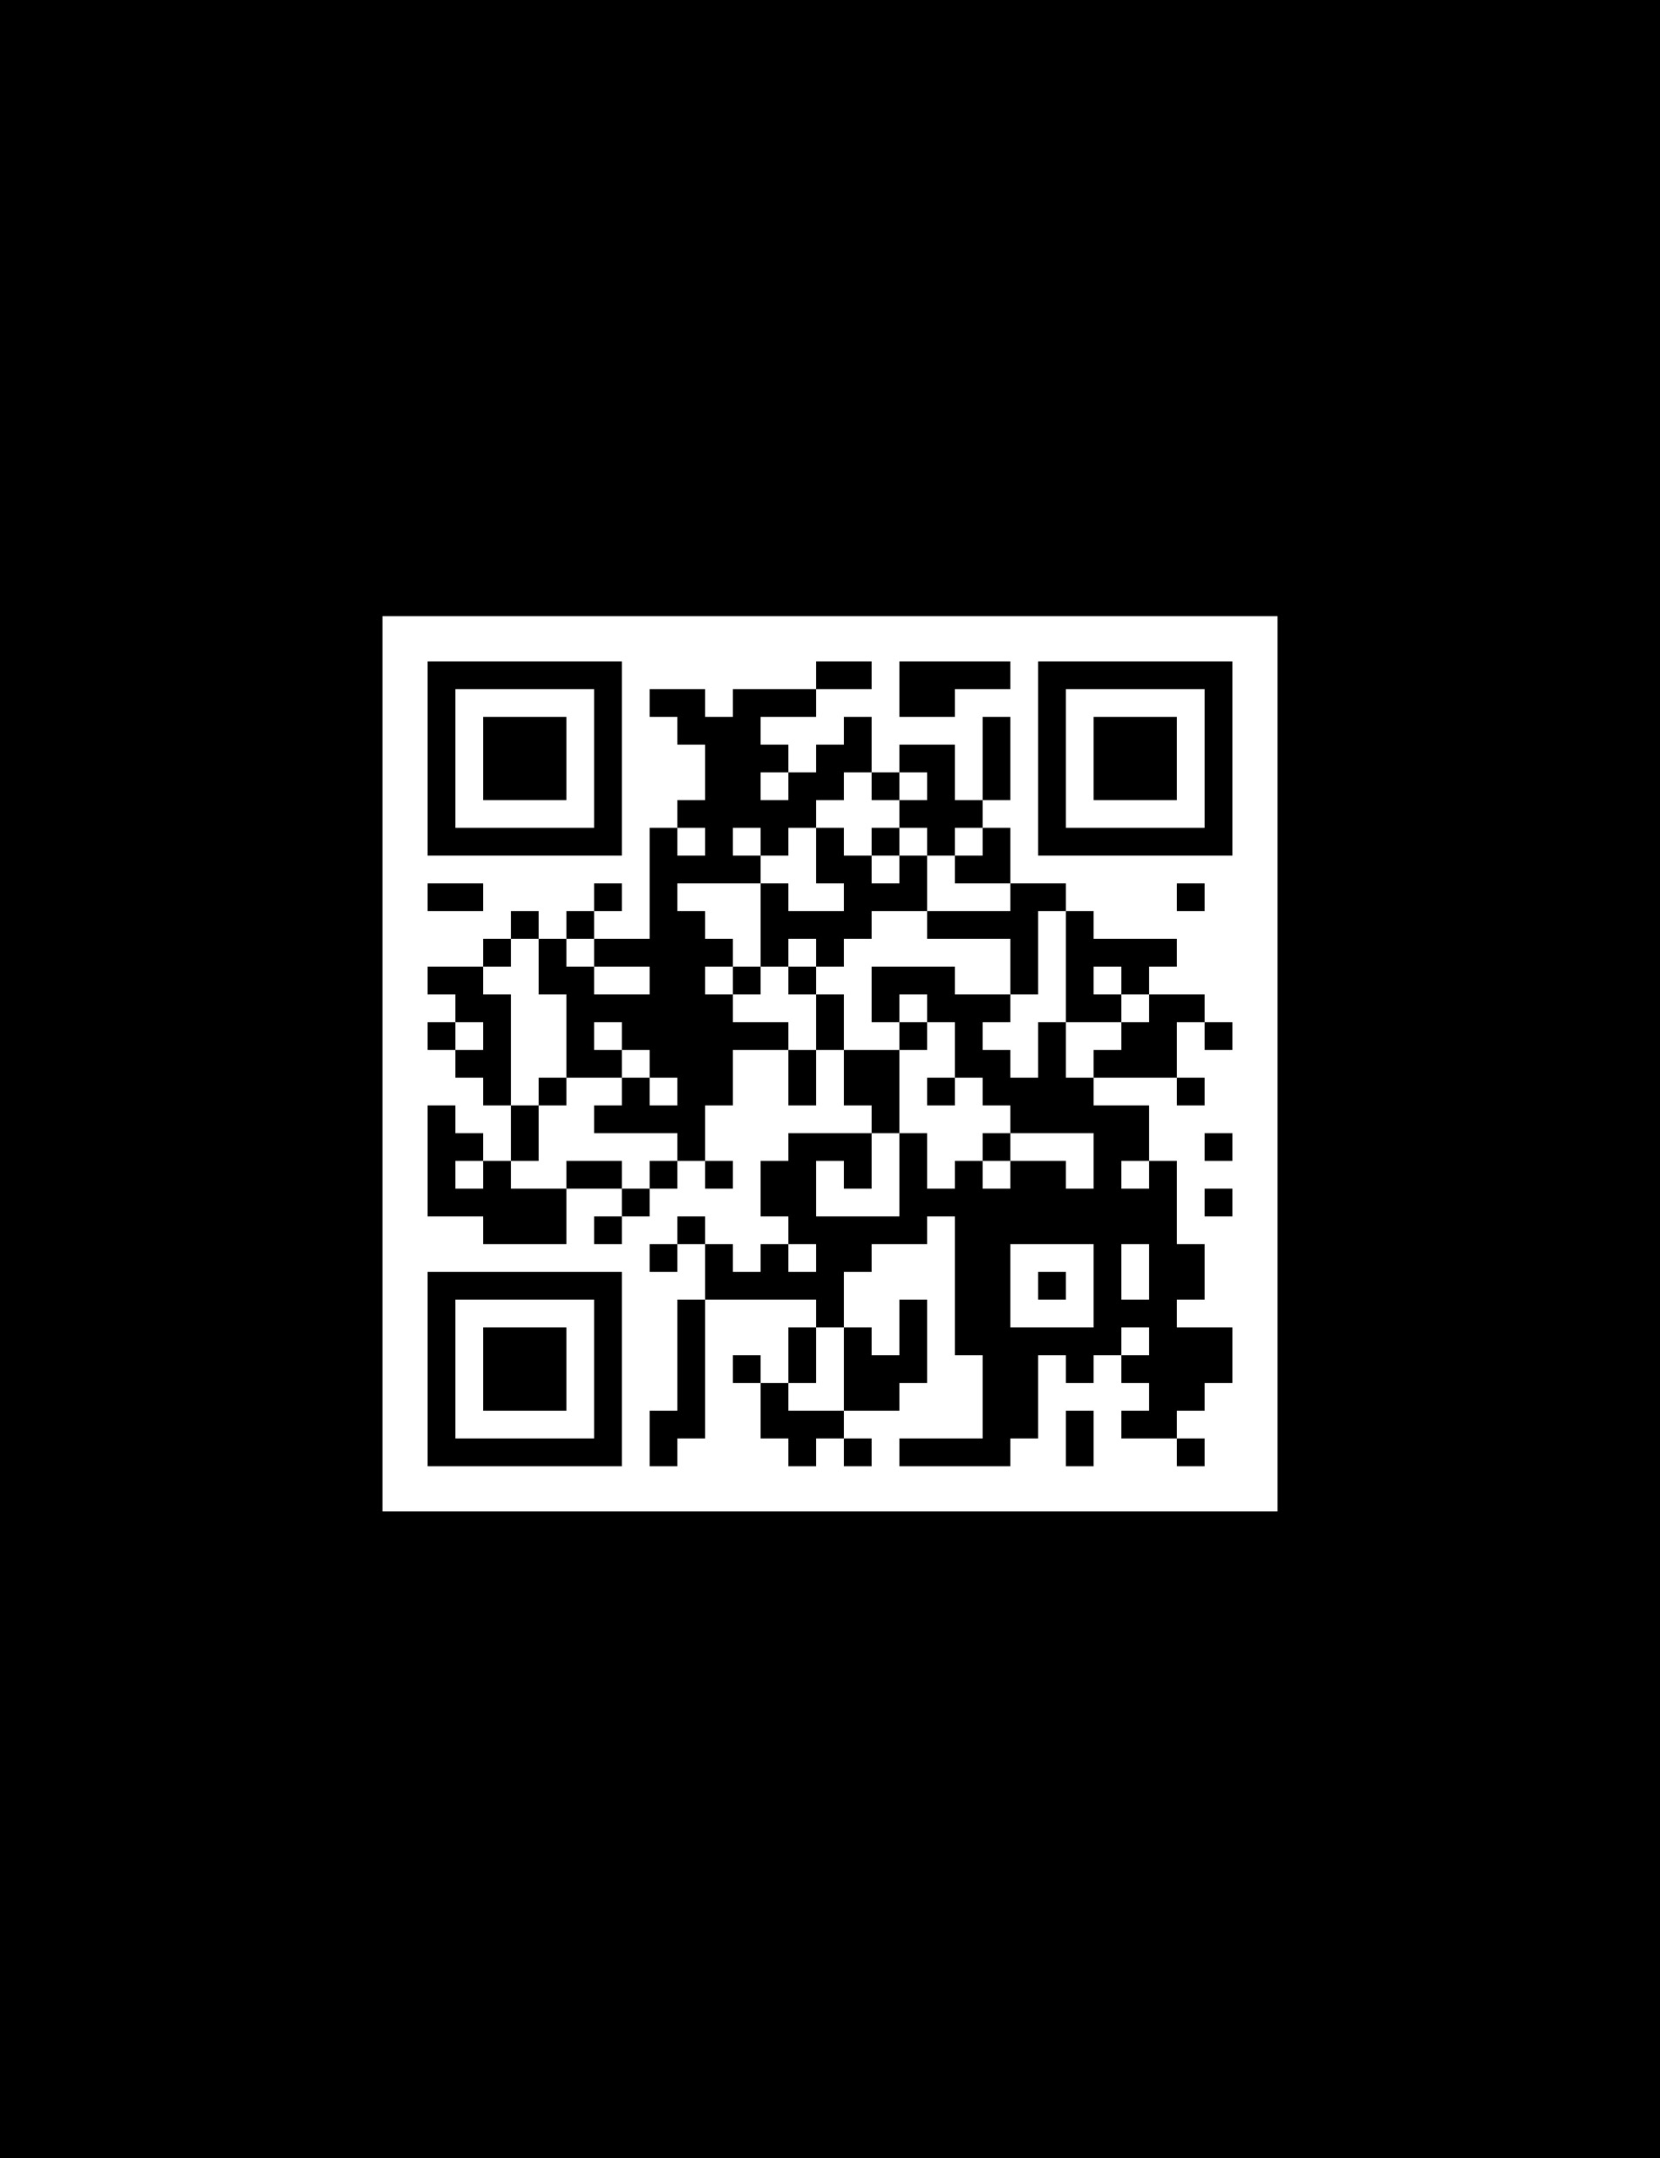

Midnight Marathon – go from “zero to hero” 27 and 28 Sep 2024 6pm IST onwards.
AI generated image from https://www.canva.com

